Slide 1

Data Analysis With Movie Reviews
Dustin Tran

Slide 2

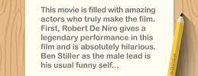
Project Motivation
Movies are a major part of the culture and often get into my news feed as well
Political significance
Audience vs critics score
Convert text to numbers?
Movie review to a score?

Slide 3
Data Collection
3 dataset sources used
2 movie data sets
Genre, description, box office numbers, director, cast, etc.
1 movie critic review data set
Critic Name, Media Organization, Review (Text), Score(0-100), etc.

Slide 4
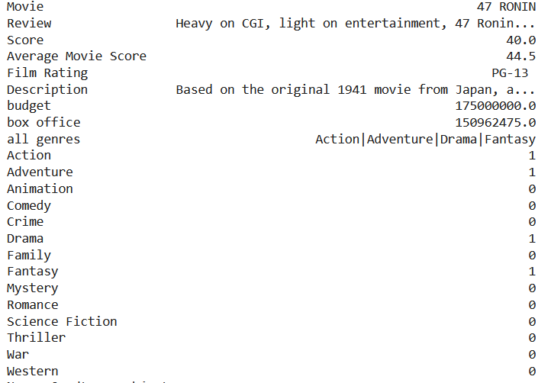
Data Collection (Continued)
Resulting Dataset
Observation Unit: movie reviews with the movie data
Variables:
Critic-related
Review (Text)
Score (0-100)
Movie-related
Description
Film Rating
Budget/ Box Office
Average Movie Score
Genre
“All Genre”
Individual Genres

Slide 5

Questions
Data Exploration
Statistics relating to movie box office and budget
Average movie scores based on movie genre(s)
Correlation between movie budget, box office, and average movie scores
Machine Learning
Can we accurately predict individual movie reviews based on the variables we have access to?

Slide 6
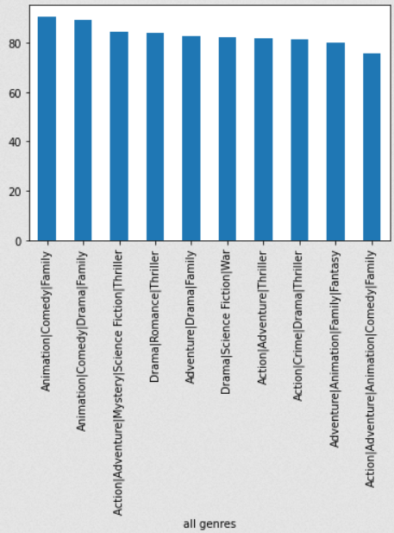
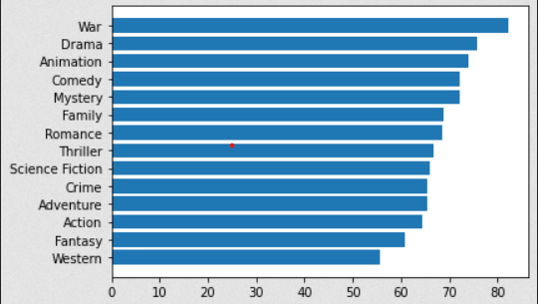
Data Exploration
96.5% of movies break even at the very least
Movies make 3.5 times their budget on average
median is 3.1 times
Individual genre do not correlate to a combination of genres
Individual Genres
Combination Genres

Slide 7
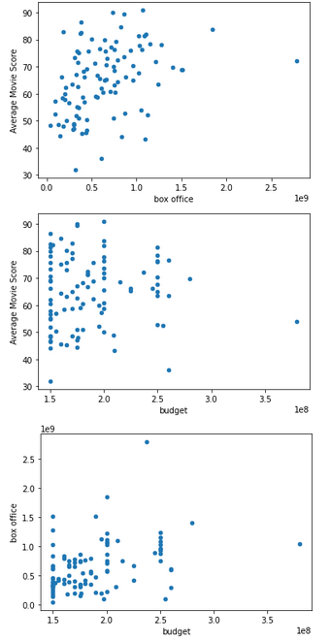
Data Exploration (Continued)
Positive Correlation
x="budget", y="box office"
0.390
x ="box office", y="Average Movie Score"
0.377
No Correlation
x="budget", y="Average Movie Score"
0.043

Slide 8
Variables to Consider for Machine Learning
Variables for testing
Review(Primary)
“This movie sucks because …”
Official Movie Description
Movie Budget and Box Office
Individual/Combination Genres
Model to Use
Linear Regression, KNN, Gradient Boosting
How many words to use in TF-IDF Vectorizer?

Slide 9
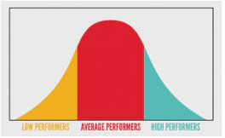
Best Configuration and Result
Configuration Used:
Linear Regression
TfidfVectorizer(max_features=2000)
Variables: 'Review', 'box office', and Individual Genres(Comedy, Action, etc..)
Average Margin of Error(RMSE):
17.09

Slide 10


Conclusion
Interpretation: 100-point system with margin of error of +- 17.1.
We cannot accurately predict critic scores with the current algorithm.
Not using enough/correct variables
Movie scores are too subjective to predict from reviews

